Slide 1


Dragon Fodder @ Fan Expo – Denver 2021
It’s All in the Whit (DND for Beginners #1)
Combining Whit & Voice (DND for Beginners #2)
The Greatest Adventure Begins with a Single Scene (DND for Beginners #3)
DND Needs You…r World! (DND for Beginners #4)
Running Your DND Game Online (DND for Beginners #5)
https://github.com/majornerd/dragonfodder
https://github.com/majornerd/dragonfodder
Notes:
https://github.com/majornerd/dragonfodder

Slide 2

Goals: Start from Zero
We will start from zero, no experience required
Participation will be rewarded
We have gifts
Targeted for Beginners, enough content that experts should have a take away or two

Slide 3
Who is Dragon Fodder?
Howard – DM – 35yrs (DM for 35yrs)
Darrel – DM – 45 yrs (DM for 5)
Jennifer – Player – 5 years of Play (4e & 5e)
Scott – Player & Pro Presenter – 3 years of Play (4e & 5e)
In Absentia
Tom – Rogue and Paladin
Guy – Cleric and Fighter
Kate – Generally just Evil
Chadd – Druid & Ranger

Slide 4
It’s PARTY play, not "person" play

Slide 5
D&D (TTRPG’s) is a game of communal storytelling

Slide 6
Dragon Fodder @ Fan Expo – Denver 2021
It’s All in the Whit (DND for Beginners #1)
Combining Whit & Voice (DND for Beginners #2)
The Greatest Adventure Begins with a Single Scene (DND for Beginners #2)
DND Needs You…r World! (DND for Beginners #2)
Running Your DND Game Online (DND for Beginners #5)
https://github.com/majornerd/dragonfodder
https://github.com/majornerd/dragonfodder
Notes:
https://github.com/majornerd/dragonfodder

Slide 7
D&D is more than just Combat
Party Play – more than any other game, party play is a key component of D&D. The entire party must be represented for the game to be a success
True Open World – D&D is limited by very little, even the rules are only suggestions. The beauty is the open nature, not bound by pixels on the screen. Bound only by your imagination
Non-combat Play – the Non-Combat portion of the game is as important, maybe more, than the combat portion. Great accomplishments in the fantasy world can come from Non-Combat play
Communal – A party is a group of people, the communal aspect is important and valuable

Slide 8
Roles at the Table
Players – Nothing can happen without players, no matter how wonderful the scenery, they are the ones to provide action!
Dungeon Master (Game Master) – The DM is the narrator and referee.

Slide 9
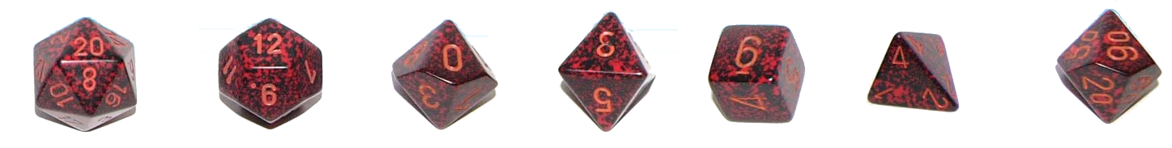
Tools We Use (Must Have)
Dice (D20, D12, D10, D8, D6, D4)
a set includes 7 die (one is a D10 marked 10-00 for rolling D100 with the other D10)
D&D 5e – Basic Rules to Play
https://media.wizards.com/2018/dnd/downloads/DnD_BasicRules_2018.pdf
D&D Beyond:
https://www.dndbeyond.com/
Free Character sheet with integrated SRD!
Post-It’s and Pens
Just really useful for notes

Slide 10
Tools We Use (Recommended)
Play Mat and Wet Erase Markers
Mat ($27.99) https://www.amazon.com/Battle-Grid-Game-Mat-36/dp/B01MQHECUR/
Markers ($12.99) https://www.amazon.com/16678B-Wet-Erase-Overhead-Transparency-Assorted/dp/B002R5AEC0
Dice Tray
Single ($8.99) https://www.amazon.com/Leather-Folding-Hexagon-Purple-Storage/dp/B07DZJJ7CS
Set of 4 ($16.99) https://www.amazon.com/K-T-Fancy-Folding-Storage-Rolling/dp/B07Y35799H
Mini’s
~$5.99 for two – I recommend your Local Gaming Store (LGS) for these
Soda Rings
(Free*) these are the plastic rings on a soda (and other) bottle.
Counters
Each D&D Mini package contains 2, but you can use coins, tokens, poker chips…..
DM Screen
Allows you to have notes and info, as well as make rolls without revealing the result *Optional

Slide 11
Tools We Use (Online Tools)
Reddit - At least 10 subreddits for D&D https://old.reddit.com
Getting Started: Player - https://www.reddit.com/r/DnD/wiki/getting_started
Getting Started: DM - https://www.reddit.com/r/DnD/wiki/new_dm_guide
DMs Guild
Tons of free content, including adventures: https://www.dmsguild.com/
DonJon – The best tools here are: Random Dungeon Generator, Encounter Size Calc, Random Generator: https://donjon.bin.sh/5e/
One Page Dungeon – Every refresh is a new dungeon (Hint: Print to PDF) https://watabou.itch.io/one-page-dungeon
Kobold Fight Club – Really good encounter builder https://kobold.club/fight/#/encounter-builder
YouTube
Matt Coleville (The best resource for a DM) - https://www.youtube.com/channel/UCkVdb9Yr8fc05_VbAVfskCA
Matt Mercer (of Critical Role fame) - https://www.youtube.com/user/geekandsundry
Podcasts
YMIAT – You Met in a Tavern - https://youmeetinatavern.podbean.com/
Critical Role - https://www.youtube.com/user/geekandsundry
The Hombrewery
Make your Homebrew look official: https://homebrewery.naturalcrit.com/
D&D 5e SRD (System Resource Document) – Homebrew: https://media.wizards.com/2016/downloads/DND/SRD-OGL_V5.1.pdf

Slide 12
Tools We Use (Online Tools)
Reddit - At least 10 subreddits for D&D https://old.reddit.com
Getting Started: Player - https://www.reddit.com/r/DnD/wiki/getting_started
Getting Started: DM - https://www.reddit.com/r/DnD/wiki/new_dm_guide
https://old.reddit.com/r/DMToolkit/
https://old.reddit.com/r/DnD/
https://old.reddit.com/r/DnDBehindTheScreen/
https://old.reddit.com/r/DnDHomebrew/
https://old.reddit.com/r/DMAcademy/
https://old.reddit.com/r/dndmonsters/
https://old.reddit.com/r/DungeonsAndDragons/
https://old.reddit.com/r/DMporn/
https://www.reddit.com/r/DnDBehindTheScreen/
https://www.reddit.com/r/onePageDungeon/
https://dmdavid.com/tag/7-dungeons-dragons-character-builds-absurdly-good-at-one-thing/
http://gdnd.wikidot.com/character-creation

Slide 13
Session Zero
Session Zero is a critical “Pre-game” session
Goals of Session Zero:
Character Creation
Align player goals
Provide background on the game world
Scheduling
Party make up
House Rules

Slide 14
Character Creation
20 questions
What do you look like
How do strangers see you
What was your upbringing
Are you still in contact with people from your childhood
Why did you become an adventurer
Where have you been already
Do you believe in the Gods? Do you follow one?
How do you feel about Magic?
What is worth dying for?
20Q Cont’d
What is your dream?
What is your stance on morals or the law
How do you deal with strangers?
How do you place a value on a person's life? Animals?
Do you see all races as the same?
Does your hero like arts?
What’s your favorite meal?
What about love?
Do you have a dark secret?

Slide 15
Character Creation
How to roll
What is important
Have fun
TALK TO THE OTHER PLAYERS!!!

Slide 16
Let’s Build a Character
(Feel free to follow along on your device)
How to handle rolls?!?
Roll 4x D6, re-roll any 1’s, discard the lowest
7 rolls, discard the lowest
Heroes not Zeroes

Slide 17
How to Play!!
When in doubt, try
Everyone’s game is different
Don’t worry about role playing

Slide 18
Phases of Play
Movement, Action, Bonus Action
Movement is limited by your total movement and modifiers
Modifiers may be terrain, character effects (Grapple, Prone, etc)
Be aware of Engagement and Opportunity Attacks
Actions are things you do:
Attack, Cast a Spell, Dash, Disengage, Dodge, Help, Hide, Ready, Search, Use an Object
Know your character sheet – D&D Beyond will automatically update your sheet with options – including multiple attacks, if possible
Bonus Action
Also things you can do, but may be dependent on something as your action
Two Weapon Fighting is a good example, requires an attack action with a simple, melee weapon; may be a spell, “bardic inspiration”
Reactions are NOT part of your turn, but an action you take based on something another player, NPC, enemy, etc., does – NOT something YOU do.

Slide 19
Pace of Play – a round is 6 seconds - total
It’s like Golf, make sure you are ready and not slowing the game down
How:
Figure out your “action” before it is your turn, so you are ready to go
Have a “Default Action” that is your go-to if you are unsure what else to do
Roll “To Hit” and “Damage” dice at the same time. If you hit, you already know your damage
Cheat sheets
Have an index card that has your commonly used attacks on it & “to hit” & Damage
Also: AC (armor class), Init (initiative)

Slide 20
Avoid::::::::
Slowing the game the same way each time
Metagaming (using information in the game that your player cannot or does not know), such as:
the stats of a monster you have never fought
information given to an individual player
information available to those in a room you are not in

Slide 21
Tip - Alignment
Alignment is simply a narration tool, not a box
Alignment Matters – LG will have conflict with CE
Lawful / Chaotic – Rules matter, or do not
Good / Evil – Benefit others or myself

Slide 22
Dragon Fodder @ Fan Expo – Denver 2021
It’s All in the Whit (DND for Beginners #1)
Combining Whit & Voice (DND for Beginners #2)
The Greatest Adventure Begins with a Single Scene (DND for Beginners #2)
DND Needs You…r World! (DND for Beginners #2)
Running Your DND Game Online (DND for Beginners #5)
https://github.com/majornerd/dragonfodder
https://github.com/majornerd/dragonfodder
Notes:
https://github.com/majornerd/dragonfodder

Slide 23
Dragon Fodder @ Fan Expo – Denver 2021
It’s All in the Whit (DND for Beginners #1)
Combining Whit & Voice (DND for Beginners #2)
The Greatest Adventure Begins with a Single Scene (DND for Beginners #3)
DND Needs You…r World! (DND for Beginners #4)
Running Your DND Game Online (DND for Beginners #5)
https://github.com/majornerd/dragonfodder
https://github.com/majornerd/dragonfodder
Notes:
https://github.com/majornerd/dragonfodder

Slide 24
Goal: To have stories to tell about the last session.
If three sessions pass without a story, revisit your DM strategy and see how you can enable the creation of one.

Slide 25
Rule #X: Steal When You Can
It is unlikely you are the first to be in this situation, the magic of Google can often provide a quick solution.

Slide 26
Rule #X: Perfection is the Enemy of Progress
When you are at the table, aim for “good enough” to move the game forward. Once the session is over, reflect and adjust. Use your session recap to announce the changes that your learning has provided.

Slide 27
Rule #X: The DM’s role is that of the Narrator and the Referee
It is NEVER you vs the players. You are NOT the BBEG, the King, the Dragon, etc.
Your job is to create tension that the players can overcome and celebrate with them when they do.
Help your players follow Ted Lasso’s Rule #1: Be a Goldfish

Slide 28
Rule #X: Let the Story Unfold at the Table
The DM brings the locations, situation, NPC’s, enemies, to the table. The players bring the motion ….. And the chaos.
Trying to play your story out won't be fun for anyone, even if you think it will be.
Let the chaos play. Chaos is where all the good stories reside.

Slide 29
Rule #X: Set the Situation and let it run
Once you setup the situation, let the players run with it. Take pleasure and joy in what they make of the building blocks you laid at their feet.
You only really have to take a hand when they are stalled in the action.
Keep some quick things you can use to “spike” the players with and jump start some action.

Slide 30
Rule #X: Help the Players find their Character
Characters are just numbers on a sheet until we bring them to life. This is not a skill that comes easy to everyone. The best DM’s help their players find who their characters are, what makes them tick and what gives them motivation.
Take some time to help your players move out of their comfort zone, or move away from the easy tropes.
Don’t try to do it all at once, but over time. Baby Steps

Slide 31
Rule #X: Rule of Cool – No, but; Yes, and…
Before you look to the rulebook, look to the rule of cool.
“If it sounds cool, it is your job to make it happen – not necessarily successful”
Remember – “You can certainly try!”

Slide 32
Rule #X: The DM is always right…. Even when they are not.
Remember, you are making a game for the rest of the table, while you are always right, be willing to take time in between sessions to accept and correct your mistakes for next time.
The DM is always right to maintain pace of play.

Slide 33
Rule #X: It is okay to kill the players
Death is a part of the game, if you DM long enough it will happen. Don’t be the only person smiling when it happens (unless it is in character as the BBEG)
BE RESPECTFUL your players have likely poured some of themselves into the character. They matter to them. Give them time to mourn. Remove as much penalty as possible to roll a new character.
Give them a reason for VENGANCE!

Slide 34
Rule #X: The Enemy is Motivated – Play It
Nothing that is evil believes itself to be evil. The greatest villain's tug at some part of us that wants to agree, then pushes a little too far.
The enemies don’t want to die
The King doesn’t want to be deposed
The Lich firmly believes they are right and just
Enemies WILL run away

Slide 35
Rule #X: Hoarding
Building tension is a simple equation. Make all resources in higher demand than supply.
Force a burn of spell slots
Eat away at Potions
Add Scarcity and your player engagement skyrockets

Slide 36
Rule #X: Allow a Grace Period
Simply give your players the time to declare their character decisions a mistake and take a mulligan.
They may not like their spell, they may not like that feat, class, whatever. Don’t put them in the position to “hate” their character, or go level after level regretting their choices.
Pay attention to those that do less damage, or frequently fail to use their resources

Slide 37
Rule #X: Use an Encounter Calculator
Balance is critical!!!! Not every encounter should be impossible or easy
Encounter Calculator, Encounter Calculator, EC
Balance…. Characters should be paced in encounters. Sometimes you want them to be winded
Figure 30 minutes per encounter
Tons of online tools:
D&D Beyond
Kobold Fight Club – Really good encounter builder https://kobold.club/fight/#/encounter-builder

Slide 38
Be Consistent
(Even when Inconsistent)

Slide 39
Party Size
There is an “ideal” party size – but it is dependent on the players and the DM
Needs to be large enough to be well rounded and competitive
Not so large chaos rules or players get bored waiting for something to do
Aim for a minimum of 4 players
Maximum of 6 Players
Consider “quorum play” when scheduling. 1 player cannot make it? No problem, someone else can drag them for a session

Slide 40
D&D Beyond is Your Best Friend
Start a Campaign
Invite your Players (using the link provided)
Share any content you have purchased (Can do rules only)
Have your players create a character in the campaign
During the campaign – keep a tab open with each player

Slide 41
Metagaming
Metagaming (using information in the game that your player cannot or does not know), such as:
the stats of a monster you have never fought
information given to an individual player
information available to those in a room you are not in

Slide 42
Dragon Fodder @ Fan Expo – Denver 2021
It’s All in the Whit (DND for Beginners #1)
Combining Whit & Voice (DND for Beginners #2)
The Greatest Adventure Begins with a Single Scene (DND for Beginners #3)
DND Needs You…r World! (DND for Beginners #4)
Running Your DND Game Online (DND for Beginners #5)
https://github.com/majornerd/dragonfodder
https://github.com/majornerd/dragonfodder
Notes:
https://github.com/majornerd/dragonfodder

Slide 43
Dragon Fodder @ Fan Expo – Denver 2021
It’s All in the Whit (DND for Beginners #1)
Combining Whit & Voice (DND for Beginners #2)
The Greatest Adventure Begins with a Single Scene (DND for Beginners #3)
DND Needs You…r World! (DND for Beginners #4)
Running Your DND Game Online (DND for Beginners #5)
https://github.com/majornerd/dragonfodder
https://github.com/majornerd/dragonfodder
Notes:
https://github.com/majornerd/dragonfodder

Slide 44
Use Inspiration when it Comes
It had been a very dry summer at the end of a set of very dry seasons, you and the others around you spent the last two nights racing down the road from an out-of-control forest fire, barely ahead of the flames.
Last night the rain started, like a blessing from the gods. As the water quenched the flames, the few survivors from the race against the flames all huddled under a makeshift tent from a tarp and some rope one person managed to save from their belongings before they were consumed by the raging inferno. You all passed out from exhaustion.
In the morning you wake, wet and cold, but alive. The flames extinguished by the torrential downpour. An old man, who you remember being in the group of you that fled from the fire, walks back into camp, walking with a limp and a make-shift cane says:

Slide 45
Use Inspiration when it Comes
“yup, it was magic.
Someone was trying to kill us”
Notes:
You have two levels of exhaustion, and your equipment is in disarray. You are unsure what you still have, and what may have been lost as you fled from the flames.

Slide 46
Start Small
Start with why, why is interesting
Why are adventurers needed?
Who runs things
What happened 200 years ago
Is this a successful empire, or is there a lost king/kingdom

Slide 47
Start Small
Start with a place, simple place,
Town, Camp Trail, Dungeon – what do the players see, hear, smell right now
Expand as they move

Slide 48
Start Small
Build over time, but see where the players are going first
Change your world to suit the narrative
If the players go west, move some of the things you have planned for the east to the west
Or, if they go west they find the cliffs of despair and nowhere to go….

Slide 49
You Meet in a Tavern
KISS – It does not need to be larger-than-life or complex
Start with “You meet in a tavern”

Slide 50
Ways to Start – Forced Meet
Negatives:
Can Be Clumsy
Trite & Boring
Forced by Definition
Positives:
Classics are classics because they work
Can be made interesting while not being a trope

Slide 51
Ways to Start – Active Participation
Negatives:
Homework
Doesn’t always work
More effort by the DM
Positives:
Integrates the players
They start with a “why”

Slide 52
Use Inspiration when it Comes
[Audience Participation]

Slide 53
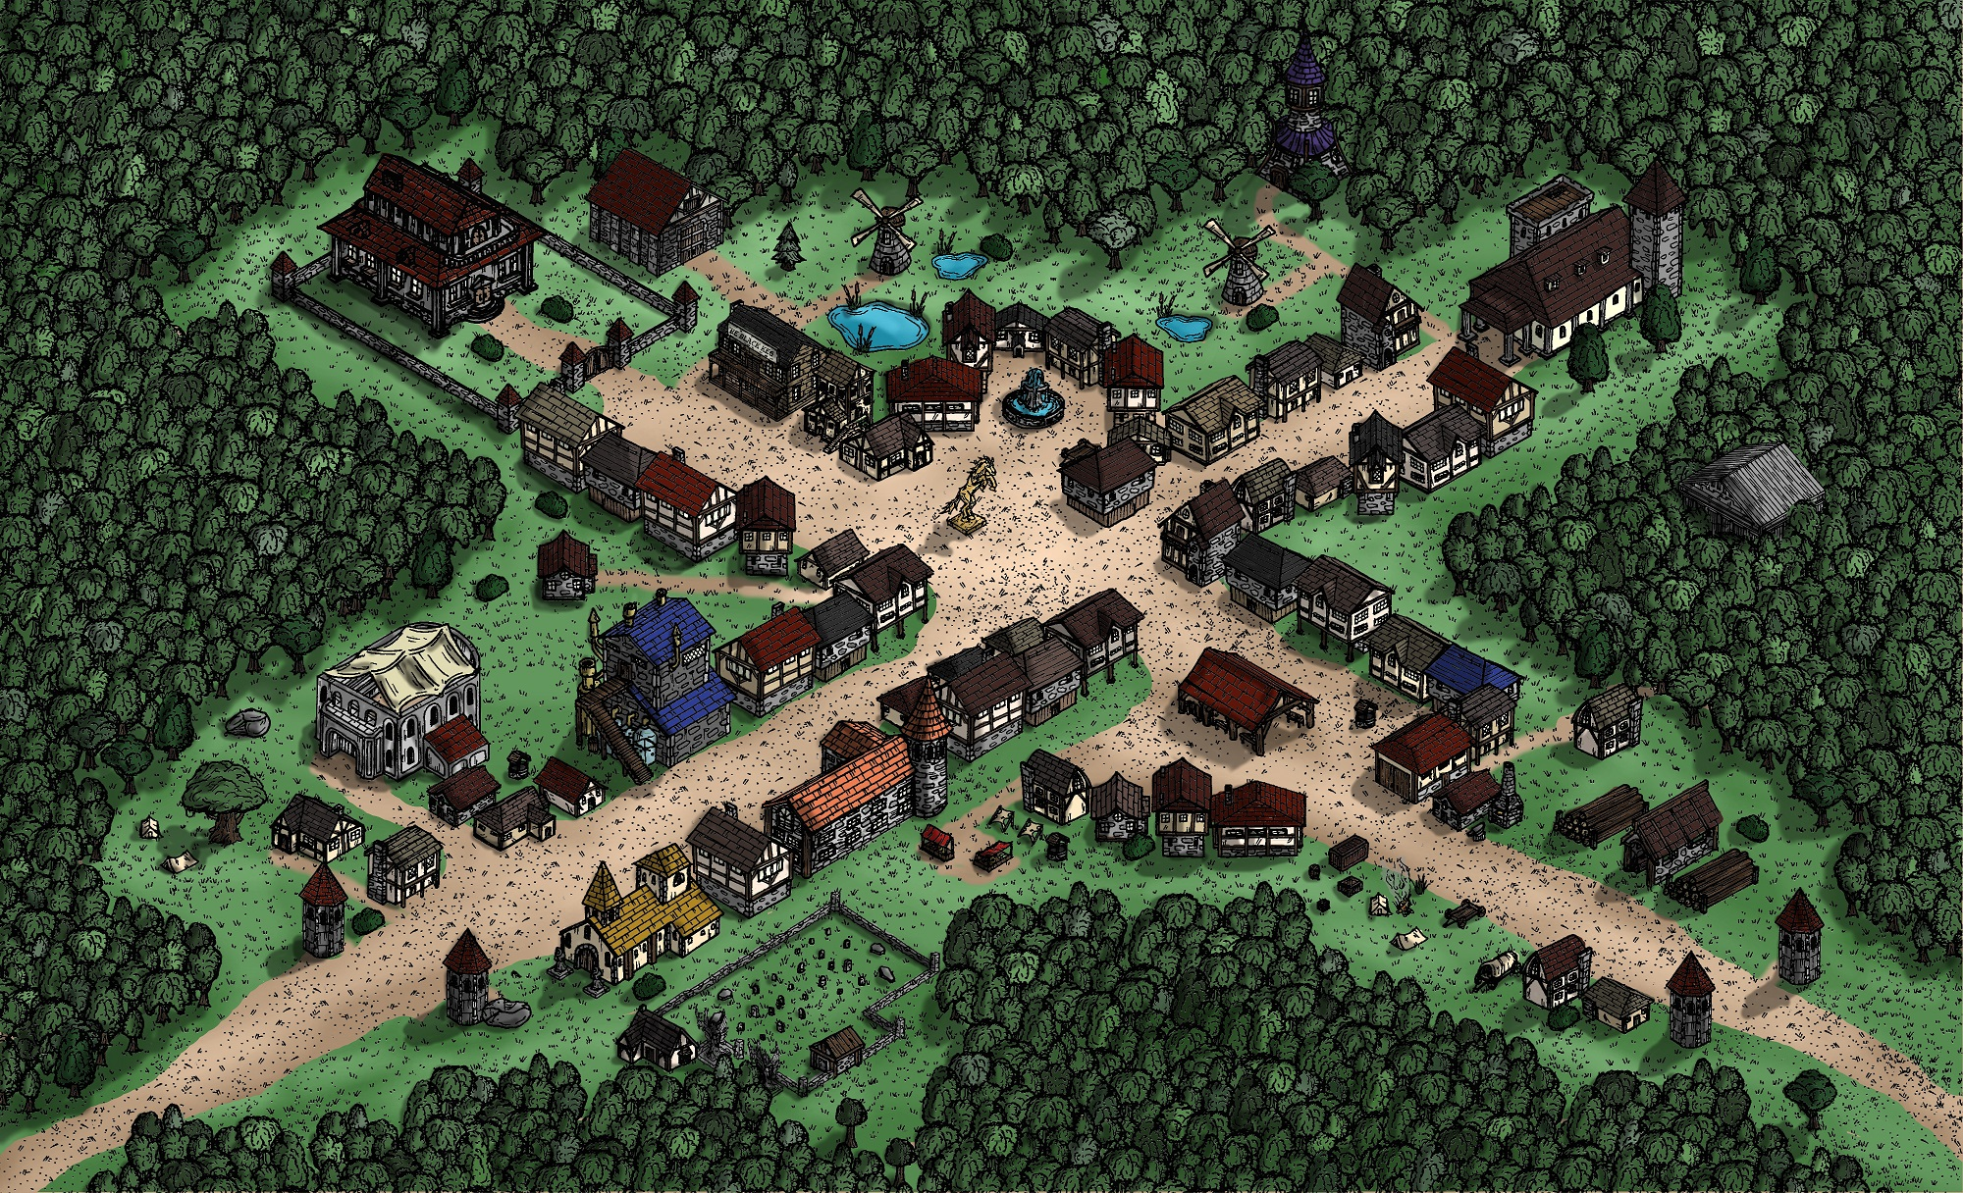
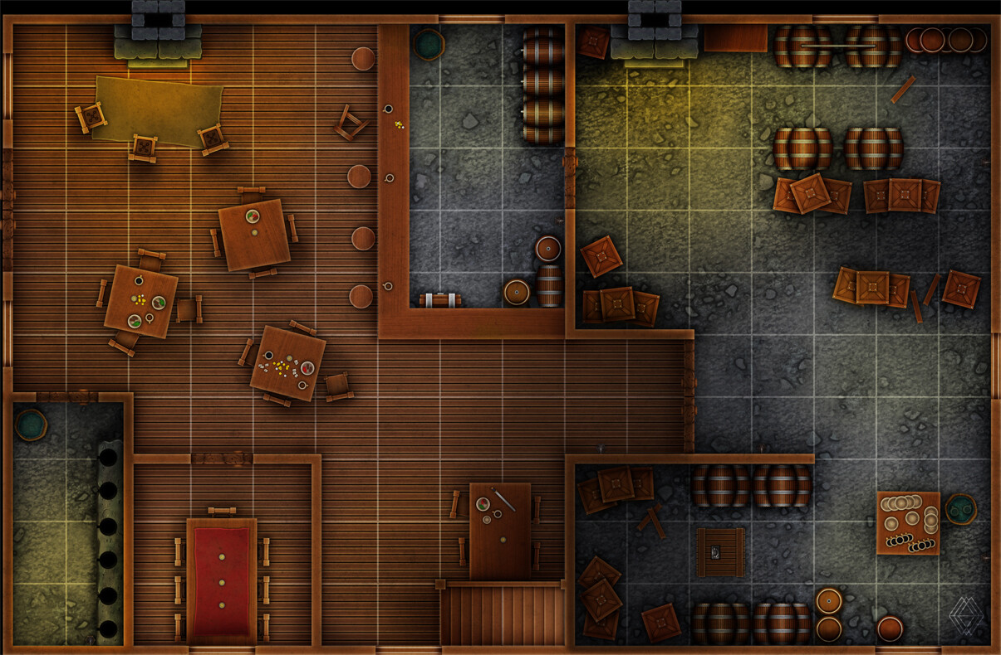
Use Google Images
<---------------Town
Tavern --------------------->

Slide 54
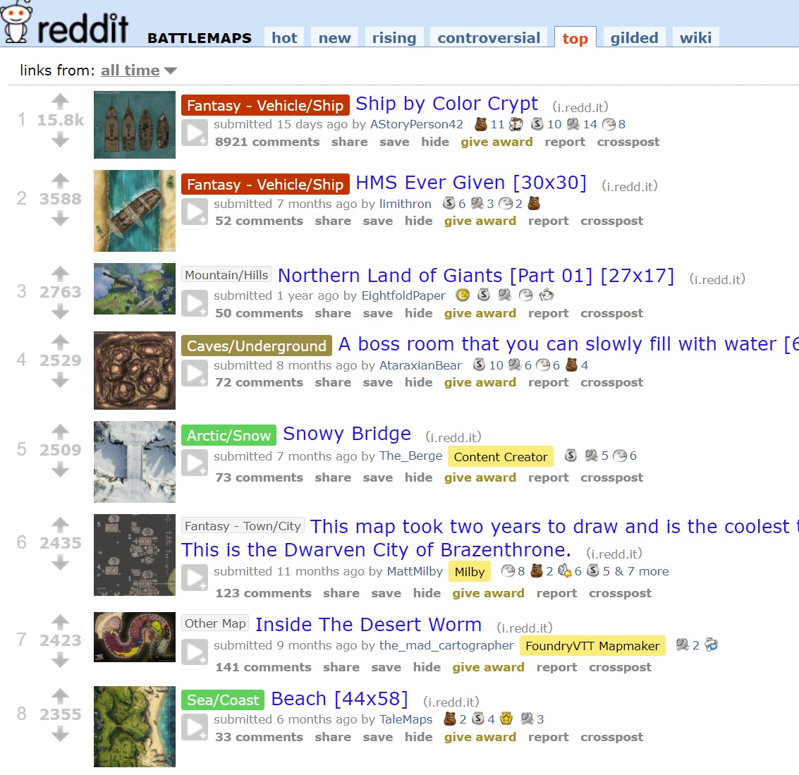
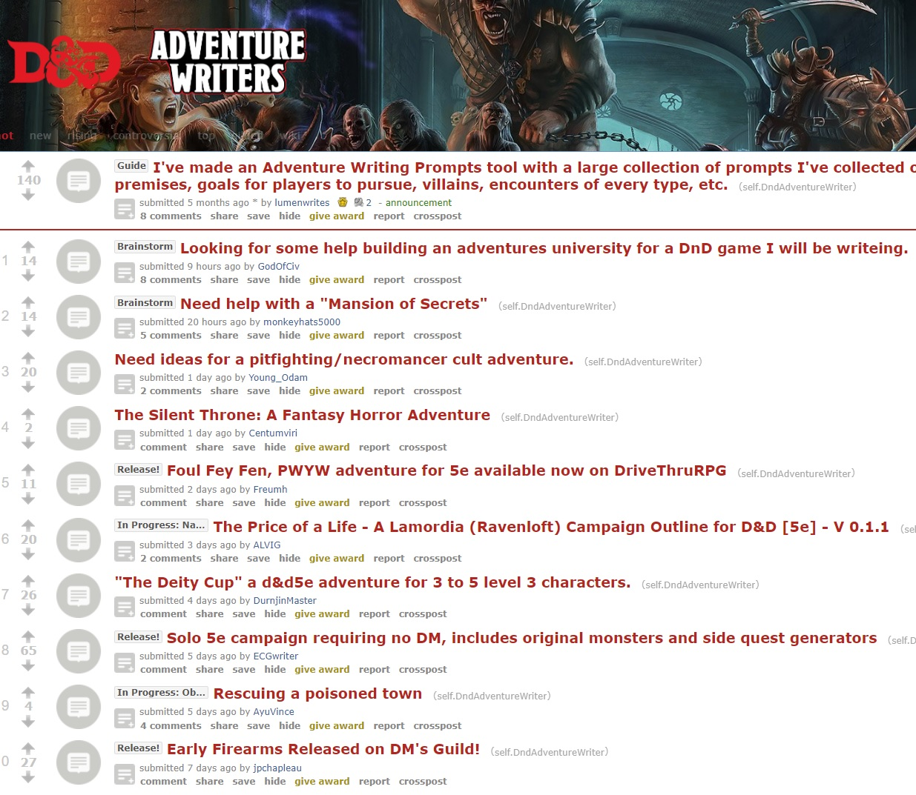
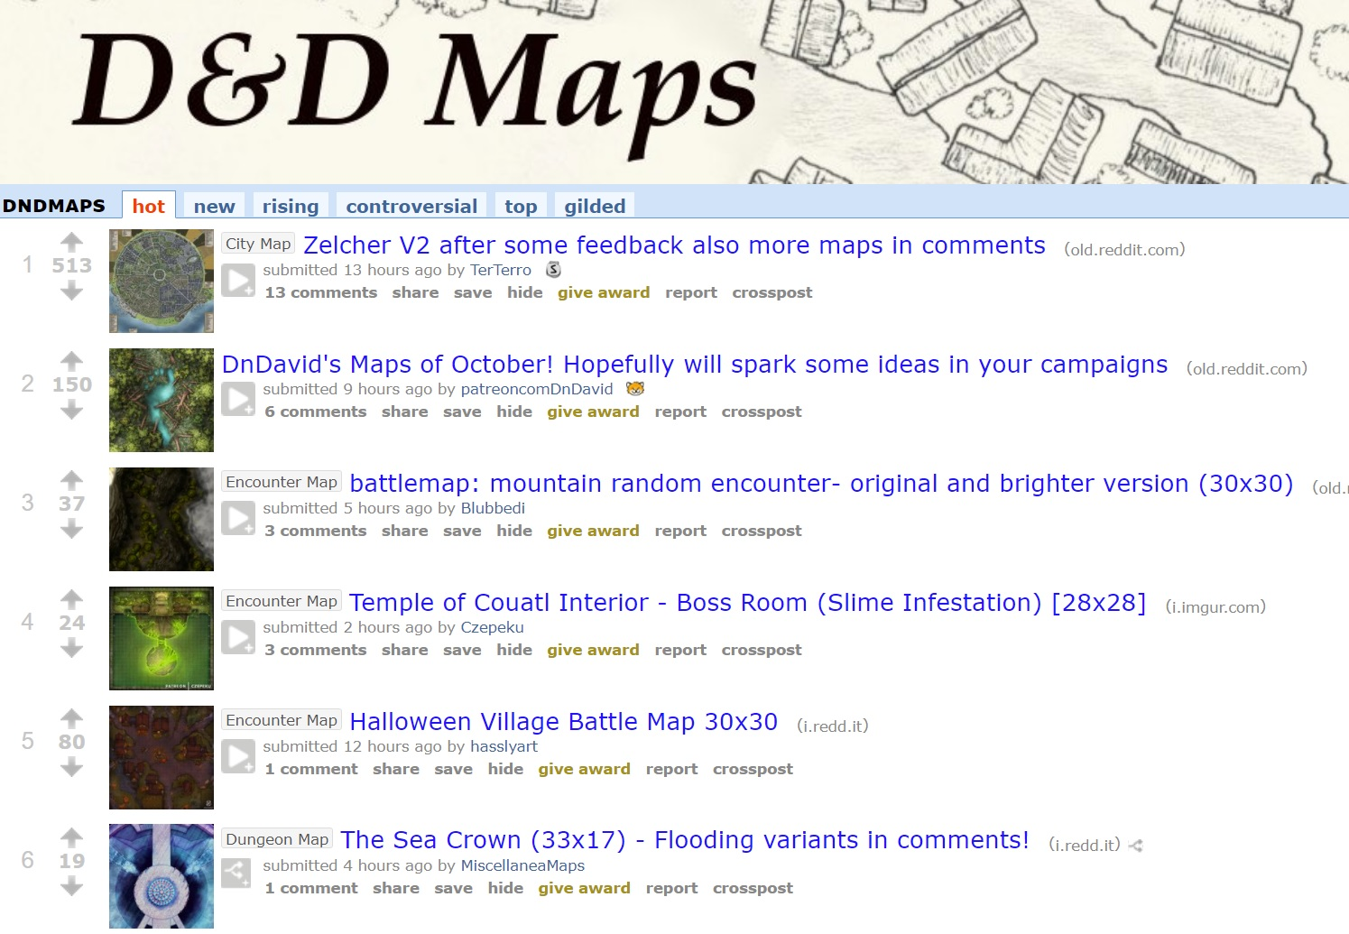
Use Reddit
←-----r/dndadventurewriters
r/battlemaps--------→
←-----r/dndmaps

Slide 55
Tools We Use (Online Tools)
DMs Guild – free content (change it to make it yours)
Tons of free content, including adventures: https://www.dmsguild.com/
DonJon – The best tools here are: Random Dungeon Generator, Encounter Size Calc, Random Generator: https://donjon.bin.sh/5e/
One Page Dungeon – Every refresh is a new dungeon (Hint: Print to PDF) https://watabou.itch.io/one-page-dungeon
Kobold Fight Club – Really good encounter builder https://kobold.club/fight/#/encounter-builder
The Homebrewery
Make your Homebrew look official: https://homebrewery.naturalcrit.com/
Fantasy Map Generator:
https://azgaar.github.io/Fantasy-Map-Generator/

Slide 56
Tools We Use (Online Tools)
Reddit - At least 10 subreddits for D&D https://old.reddit.com
https://old.reddit.com/r/DMToolkit/
https://old.reddit.com/r/DnD/
https://old.reddit.com/r/DnDBehindTheScreen/
https://old.reddit.com/r/DnDHomebrew/
https://old.reddit.com/r/DMAcademy/
https://old.reddit.com/r/dndmonsters/
https://old.reddit.com/r/DungeonsAndDragons/
https://old.reddit.com/r/DMporn/
https://www.reddit.com/r/DnDBehindTheScreen/
https://www.reddit.com/r/onePageDungeon/
https://dmdavid.com/tag/7-dungeons-dragons-character-builds-absurdly-good-at-one-thing/
http://gdnd.wikidot.com/character-creation

Slide 57
Dragon Fodder @ Fan Expo – Denver 2021
It’s All in the Whit (DND for Beginners #1)
Combining Whit & Voice (DND for Beginners #2)
The Greatest Adventure Begins with a Single Scene (DND for Beginners #3)
DND Needs You…r World! (DND for Beginners #4)
Running Your DND Game Online (DND for Beginners #5)
https://github.com/majornerd/dragonfodder
https://github.com/majornerd/dragonfodder
Notes:
https://github.com/majornerd/dragonfodder

Slide 58
Dragon Fodder @ Fan Expo – Denver 2021
It’s All in the Whit (DND for Beginners #1)
Combining Whit & Voice (DND for Beginners #2)
The Greatest Adventure Begins with a Single Scene (DND for Beginners #3)
DND Needs You…r World! (DND for Beginners #4)
Running Your DND Game Online (DND for Beginners #5)
https://github.com/majornerd/dragonfodder
https://github.com/majornerd/dragonfodder
Notes:
https://github.com/majornerd/dragonfodder

Slide 59
Start Small
Start with why, why is interesting
Why are adventurers needed?
Who runs things
What happened 200 years ago
Is this a successful empire, or is there a lost king/kingdom

Slide 60
Liminality - describe the psychological process of transitioning across boundaries and borders
The goal is to break the barrier to make your world feel real.
Not that it is real, but that it COULD be
Coherent and Consistent
It must have the same drivers that this world does
It must be consistent, even when it is not

Slide 61
What drives the real world?
Drivers of Reality:
People
Economy
Weather & Ecology
Freedom and Agency
Power

Slide 62
What is missing?
Technology and Magic are not drivers of the real world (or fake world in the case of Magic)

Slide 63
People
How do people congregate?
Look to history
Population density is a huge factor in low-tech nations (exchange magic for tech)
Up to about 1500 AD the highest density population in any European nation was about 100 people per sq mile. London, Rome, Paris, Berlin, etc…. 100ppl
It requires a tremendous amount of land to raise cattle and farm in pre-industrial world to feed people
Clean water was a valuable resource. No clean water = no people
Hand digging a well changes where you can live and prosper
Large changes in population
Decreases happened frequently – famine, harsh weather, plague, war all drove population down
Increases were nearly unheard of, except in the case of massive migrations

Slide 64
Economy
How is wealth created?
Look to history
How has magic changed the economy?
Has it always existed?
Is it a limited resource?
Does it require an education or training?
Who controls the universities?
How is it limited? Wish cannot be unlimited?
If it is limited, how is the knowledge shared and continued?

Slide 65
Economy
How is wealth created?
Herd based societies are generally highly mobile and may come to a place at the time of the year when you sell the herd for slaughter
May make a tent city
Herd people tend to be closed off and not trusting of outsiders (everything is a predator)
Farming is almost completely water dependent. Terraforming is very complex because the centuries of water have produced ecological material that creates good soil
Establishment is key
Change is slow
Drought & Extreme (unplanned) cold

Slide 66
Weather & Ecology
Weather & Ecology control the expansion of humanoids
Cities are ALWAYS built near water, until the ability to move goods make water available everywhere
Phoenix can only exist because we can move products very quickly
Does magic allow for the creation of food? Water? In massive volumes?
If not, then how does your city exist?
Ancient cities were part Fort
If flying is common (dragons) then what are the walls protecting?
Walls CANNOT be exclusive of the water source, unless you are making a prison camp
How do the structure decisions reflect the weather and land?
Are your oceans filled with salt water? How does the corrosion effect buildings?
If you have deserts, how do you manage water?

Slide 67
Freedom & Agency
How free do the people of your world feel?
Is there a caste system in place?
Does the whole (known) world follow the same system?
Do the people know of different systems?
Are they fighting for a change?

Slide 68
Power!
Wealth
How is personal wealth created?
Can magic create wealth?
Religion
How organized is religion?
How directly do the Gods take a hand in the world
How “real” is the translation between the Gods and their followers?
Status
How does one gain or lose status?
Are there guilds in your world? What do the guilds control?

Slide 69
Additional Resources
30 Days of Worldbuilding:
http://www.web-writer.net/fantasy/days/
Reddit forum on Worldbuilding
https://www.reddit.com/r/worldbuilding/
Climate Classifications
https://vividmaps.com/climate-classification-systems/
Religion Creation Primer
https://inkwellideas.com/worldbuilding/worldbuilding-religion-design/
Animal Niches (for filling up the fauna of your world)
https://www.reddit.com/r/SpeculativeEvolution/comments/9mxk9c/a_list_i_compiled_of_common_animal_niches/
People in the Medieval world
https://medium.com/migration-issues/notes-on-medieval-population-geography-fd062449364f

Slide 70
Map Generators
Island/Volcanic Map:
https://www.redblobgames.com/maps/mapgen2/
Fantasy City Map:
https://watabou.itch.io/medieval-fantasy-city-generator
Map Painter
https://www.redblobgames.com/maps/mapgen4/
City Painter
http://citypainter.watabou.ru/
Nerd all the way out: https://docs.google.com/document/d/1TKoyrApuKeynNIh_hYUPXMXgFUaS3LJ3USLS0s9HrB0/edit

Slide 71
Dragon Fodder @ Fan Expo – Denver 2021
It’s All in the Whit (DND for Beginners #1)
Combining Whit & Voice (DND for Beginners #2)
The Greatest Adventure Begins with a Single Scene (DND for Beginners #3)
DND Needs You…r World! (DND for Beginners #4)
Running Your DND Game Online (DND for Beginners #5)
https://github.com/majornerd/dragonfodder
https://github.com/majornerd/dragonfodder
Notes:
https://github.com/majornerd/dragonfodder

Slide 72
Dragon Fodder @ Fan Expo – Denver 2021
It’s All in the Whit (DND for Beginners #1)
Combining Whit & Voice (DND for Beginners #2)
The Greatest Adventure Begins with a Single Scene (DND for Beginners #3)
DND Needs You…r World! (DND for Beginners #4)
Running Your DND Game Online (DND for Beginners #5)
https://github.com/majornerd/dragonfodder
https://github.com/majornerd/dragonfodder
Notes:
https://github.com/majornerd/dragonfodder

Slide 73
Virtual Tabletops
Astral: http://astraltablerop.com/
Cost: Free; Pro - $9.99/mo or $99.99/yr
Massive improvements since start of Covid
No D&D Store – so official content is “difficult”
Fantasy Grounds: http://fantasygrounds.com/
Cost: Ultimate ($149.99 or $9.99/mo); Standard ($39.99 or $3.99/mo); Free (can only join a game run by an Ultimate subscriber)
Has a store, can run pre-built campaigns
Roll20: http://www.Roll20.net
Cost: Free; Plus ($4.99/mo); Pro ($9.99/mo)
Has a robust store, easy-ish to run pre-built content
Beyond20 integrates Roll20 & DnDBeyond
*this is what I use*

Slide 74
Dragon Fodder @ Fan Expo – Denver 2021
It’s All in the Whit (DND for Beginners #1)
Combining Whit & Voice (DND for Beginners #2)
The Greatest Adventure Begins with a Single Scene (DND for Beginners #3)
DND Needs You…r World! (DND for Beginners #4)
Running Your DND Game Online (DND for Beginners #5)
https://github.com/majornerd/dragonfodder
https://github.com/majornerd/dragonfodder
Notes:
https://github.com/majornerd/dragonfodder

